Slide 1
Theory of Dynamic Symbolic Execution
By
Xi Ge
Dayoung Lee
Xusheng Xiao
Towards
Partial fulfillment for Course 707

Slide 2
Overview
Introduction to dynamic symbolic execution
Path explosion problem
NP-complete problem
Greedy algorithm: fitness
String constraint solver
Context free grammar
Symbolic Grammar
Context free grammar

Slide 3
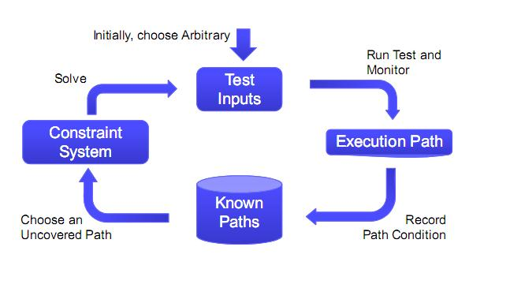
Dynamic Symbolic Execution

Slide 4
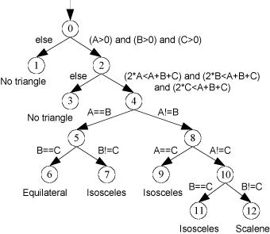
Path Explosion
CFG (control flow graph)
Each program under test could be modeled as CFG.
To achieve 100% path coverage is in NPC.

Slide 5
Path Explosion
Heuristic: Fitness Guided Explosion
Fitness Function: Measure the current state and the goal state.
Public bool TestLoop(int x, int[] y){
if(x==90){
for(int i=0; i<y.length;i++)
if(y[i]==15)
x++;
If(x==110) Fitness function: |110-x|
return true;
}
return false;
}

Slide 6
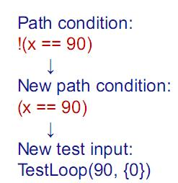
Example
Public bool TestLoop(int x, int[] y){
if(x==90){
for(int i=0; i<y.length;i++)
if(y[i]==15)
x++;
If(x==110)
return true;
}
return false;
}
TestLoop(0,{0})

Slide 7
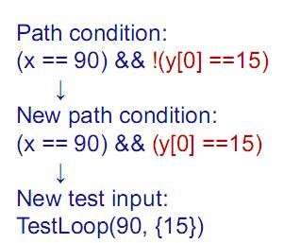
Example
Public bool TestLoop(int x, int[] y){
if(x==90){
for(int i=0; i<y.length;i++)
if(y[i]==15)
x++;
If(x==110)
return true;
}
return false;
}
TestLoop(90,{0})

Slide 8
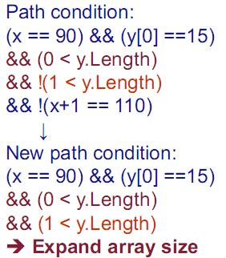
Example
Public bool TestLoop(int x, int[] y){
if(x==90){
for(int i=0; i<y.length;i++)
if(y[i]==15)
x++;
If(x==110)
return true;
}
return false;
}
TestLoop(90,{15})

Slide 9
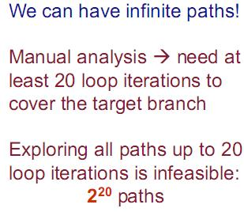
Example
Public bool TestLoop(int x, int[] y){
if(x==90){
for(int i=0; i<y.length;i++)
if(y[i]==15)
x++;
If(x==110)
return true;
}
return false;
}

Slide 10
Fitness Function
Fitness Function: Measure the current state and the goal state.
Public bool TestLoop(int x, int[] y){
if(x==90){
for(int i=0; i<y.length;i++)
if(y[i]==15)
x++;
If(x==110) Fitness function: |110-x|
return true;
}
return false;
}

Slide 11
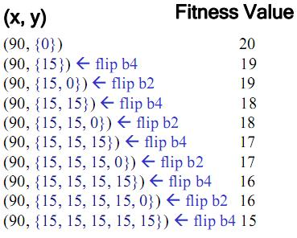
Using Fitness Function to Guide
Public bool TestLoop(int x, int[] y){
if(x==90){
for(int i=0; i<y.length;i++)
if(y[i]==15)
x++;
If(x==110)
return true;
}
return false;
}

